Slide 1
Memory Management

Slide 2
Background
It is a method of managing various types of memory especially the primary memory (RAM).
Program must be brought secondary memory (from disk) into primary memory and placed within a process for it to be run
Main memory (RAM) and registers are only storage CPU can access directly

Slide 3
Multiprogramming
Multiple Programs stored at the same time
into different areas of memory
Processor needs to context switch
Programs use memory addresses / references
Proper addressing is required
no matter where the program is located in memory

Slide 4
Degree of Multiprogramming
CPU utilization = 1 – P^{n}
n process in memory
P is the I/O block time by one process
P^{n} probability of all process are waiting for I/O
I/O waiting 80% of time
CPU utilization = 1 – 0.8¹ =20% [1 process @ memory ]
CPU utilization = 1 – 0.8³ =49% [3 processes @ memory ]
CPU utilization = 1 – 0.8¹⁰ =89% [10 processes @ memory ]

Slide 5
Swapping
A process can be swapped temporarily out of memory to a backing store, and then brought back into memory for continued execution
Total physical memory space of processes can exceed physical memory
If next processes to be put on CPU is not in memory, need to swap out a process and swap in target process
Context switch time can then be very high

Slide 6
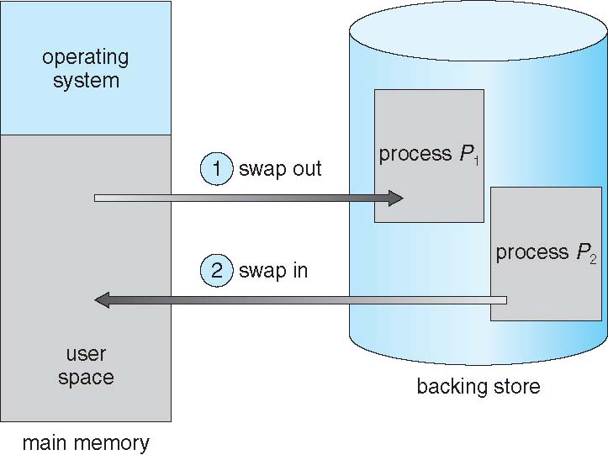
Schematic View of Swapping

Slide 7
Memory Management Techniques
Contiguous
Fixed partitioning (static)
Variable partitioning (dynamic)
Non-contiguous
Paging
Segmentation

Slide 8
Contiguous Allocation
Base register contains value of smallest physical address
Limit register contains range of logical addresses – each logical address must be less than the limit register
MMU maps logical address dynamically

Slide 9
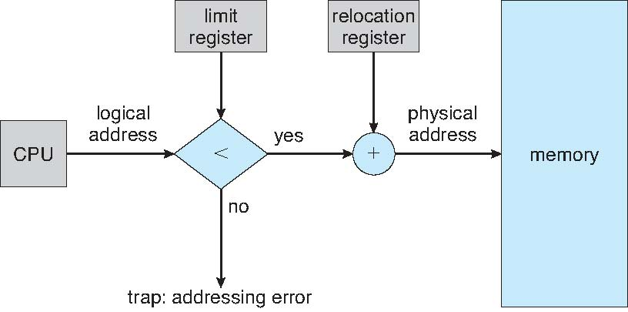
Hardware Support for Relocation and Limit Registers

Slide 10
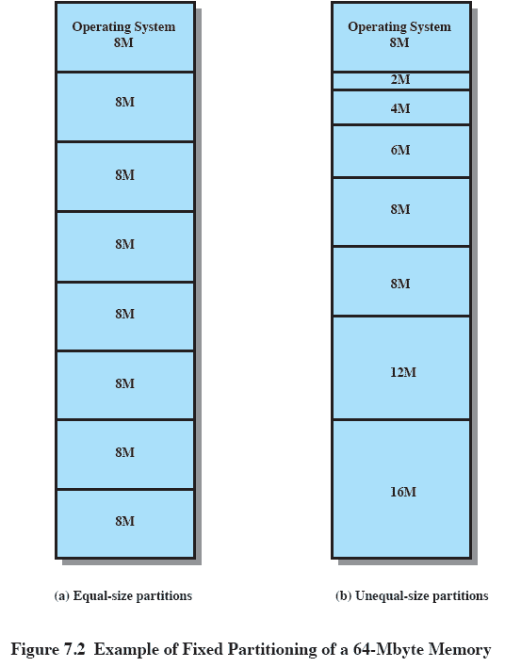
Fixed Partitioning

Slide 11
Fixed Partitioning
Number of partitions are fixed
Size of each partition may or may not be same
Since contiguous allocation, so spanning is not allowed
Disadvantages:
Internal fragmentation
Process size is limited
Limitations on degree of multiprogramming

Slide 12
Variable Partitioning
There are no partitions beforehand.
Partition will be created according to the process size during runtime.
Advantages:
No internal fragmentation
No limitation on number of processes
No limitation on process size
Disadvantages:
External fragmentation (hole) will be created.
Allocation and reallocation is complex.

Slide 13
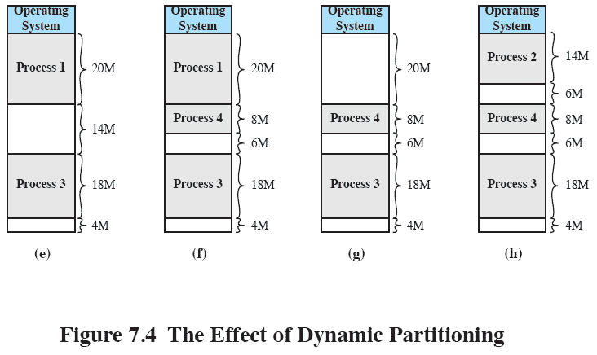
Effects of Variable Partitioning

Slide 14
Dynamic Storage-Allocation Problem
How to satisfy a request of size n from a list of free holes?
First-fit: Allocate the first hole that is big enough
Best-fit: Allocate the smallest hole that is big enough; must search entire list, unless ordered by size
Produces the smallest leftover hole
Worst-fit: Allocate the largest hole; must also search entire list
Produces the largest leftover hole

Slide 15
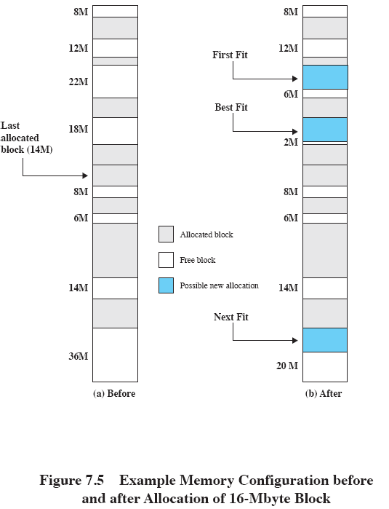
Allocation Schemes

Slide 16





Fragmentation
Internal Fragmentation
(inside partition)
External Fragmentation
(between two process)
- Fixed Size Partition
- In-efficient memory utilization
- Small prog occupies entire partition
Variable size partition
Worst case, would have a block of free memory
Sol^{n} - Compaction

Slide 17
Compaction
Reduce external fragmentation by compaction
Shuffle memory contents to place all free memory together in one large block
Compaction is possible only if relocation is dynamic, and is done at execution time
Disadvantages
Before shifting, the processes at running states need to be halted
Time consuming

Slide 18
Paging
Physical address space of a process can be noncontiguous; process is allocated physical memory whenever the latter is available
Avoids external fragmentation
Avoids problem of varying sized memory chunks
Divide physical memory into fixed-sized blocks called frames
Size is power of 2, between 512 bytes and 16 Mbytes
Divide logical memory into blocks of same size called pages
Keep track of all free frames
To run a program of size N pages, need to find N free frames and load program
Set up a page table to translate logical to physical addresses
Backing store likewise split into pages

Slide 19
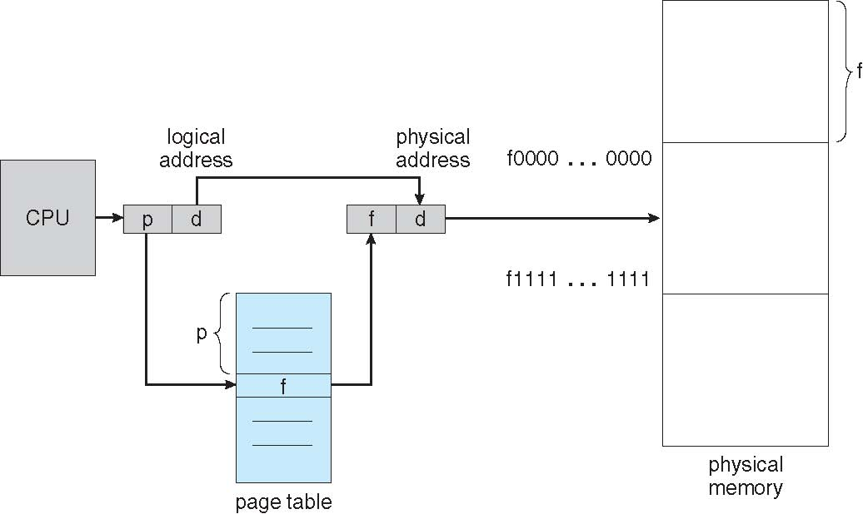
Paging Hardware

Slide 20
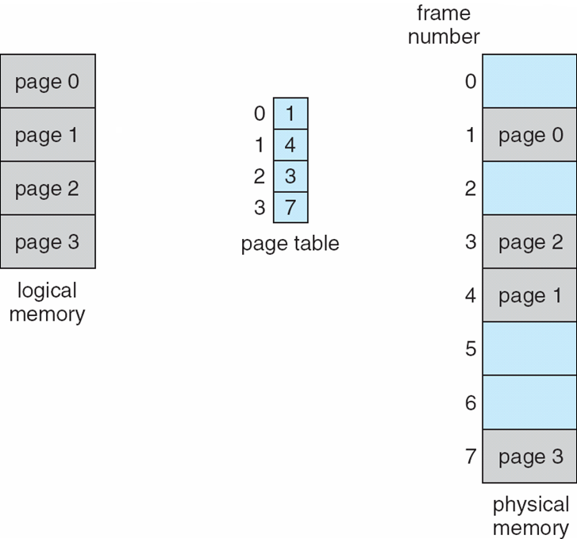
Paging Model of Logical and Physical Memory

Slide 21
Paging Explained With an Example
Frame number
Bytes
0
0 1
CCCCCDCDVCPUV\\\V
0
0 1
Bytes
1
2 3
2
4 5
1
2 3
3
6 7
Page number
4
8 9
Physical address 9 generated by MMU
Process1
5
10 11
1
1
6
12 13
3
1
1
1
7
14 15
Page number
Page offset
0
frame2
100
1
RAM
1
frame4
Frame number
Frame offset
Logical address 3 generated by CPU
Page table of process1

Slide 22
Paging Explained With an Example(cont.)
Process size is 4B
Page size is 2B
Number of pages is 2 (4/2).
RAM size is 16B
Frame size is 2B
Number of frames is 8 (16/2).

Slide 23
Paging Calculations
Consider a system which has logical address which is represented by 7 bits, physical address represented by 6 bits, page size of 8 bytes, then calculate number of pages and number of frames.
4
3
3
3
Page number
Page offset
Frame number
Frame offset
Logical address
Physical address

Slide 24
Paging Calculations (Cont.)
Total number of pages= 2⁴=16
Total number of frames= 2³=8
Logical address space=2⁷=128
Physical address space=2⁶=64
Number of entries in a page table of a process= number of pages in a process =16

Slide 25
Powers of 2
2¹=2 2⁸=256
2²=4 2⁹=512
2³=8 2¹⁰=1K
2⁴=16 2²⁰=1M
2⁵=32 2³⁰=1G
2⁶=64 2⁴⁰=1T
2⁷=128

Slide 26
Implementation of Page Table
Page table is kept in main memory
Page-table base register (PTBR) points to the page table
Page-table length register (PTLR) indicates size of the page table
In this scheme every data/instruction access requires two memory accesses
One for the page table and one for the data / instruction
The two memory access problem can be solved by the use of a special fast-lookup hardware cache called associative memory or translation look-aside buffers (TLBs)

Slide 27
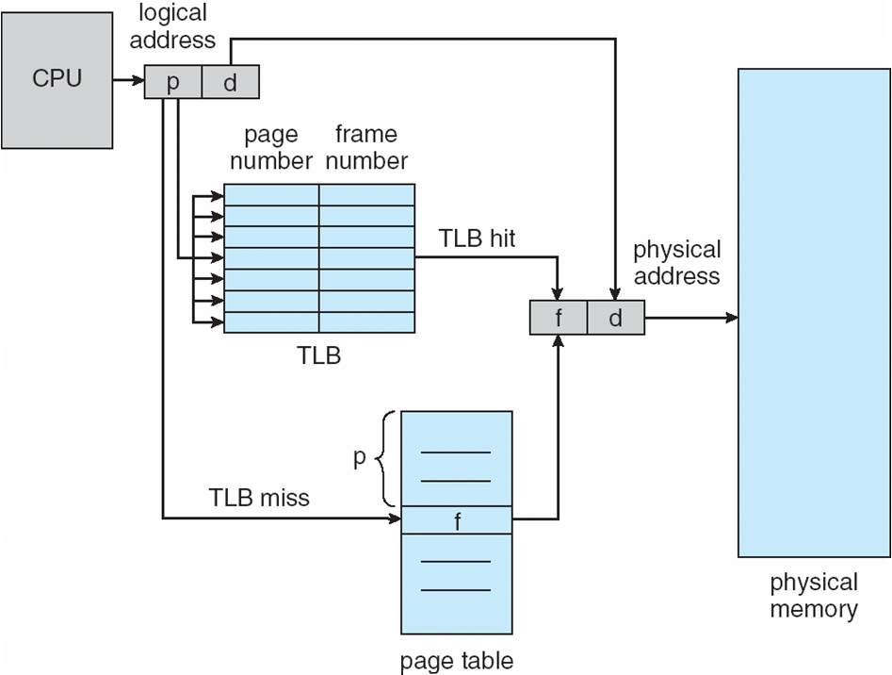
Paging Hardware With TLB

Slide 28
Effective Memory Access Time
Effective access time=
#TLB hit x (TLB access time + memory access time) +
#TLB miss x (TLB access time + Page table access time + memory access time)
Memory Access Time 100 nanoseconds
100% hit ratio:1.0 x (20+100) nanoseconds =120 nanoseconds
80% hit ratio:0.8 x (20+100) + 0.20x (20+100+100) nanoseconds=140 nanoseconds
98% hit ratio:0.98 x (20+100) + 0.02x (20+100+100) nanoseconds
=122 nanoseconds

Slide 29
Segmentation
Memory-management scheme that supports user view of memory
A program is a collection of segments
A segment is a logical unit such as:
main program
procedure
function
method
object
local variables, global variables
common block
stack
symbol table
arrays

Slide 30
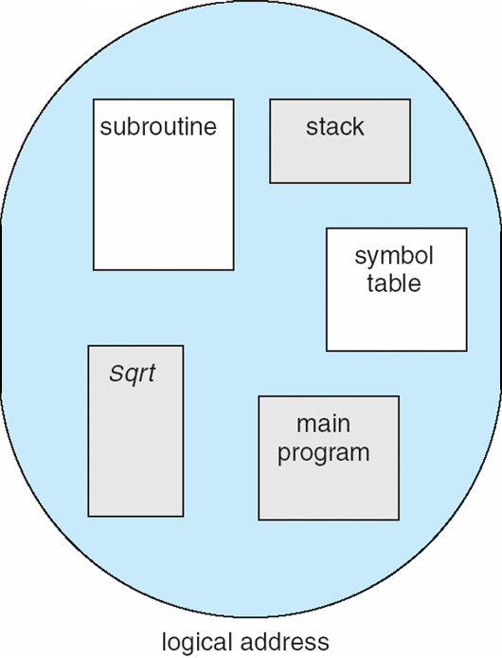
User’s View of a Program

Slide 31
Logical View of Segmentation
1
1
4
2
3
4
2
3
user space
physical memory space

Slide 32
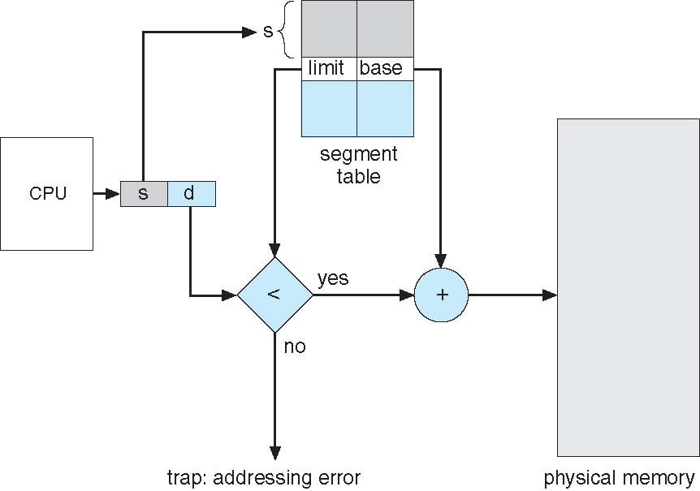
Segmentation Hardware

